Slide 1
HTTP Status Codes
HTTP response status codes indicate whether a specific HTTP request has been successfully completed. Responses are grouped in five classes:
Informational responses,
Successful responses,
Redirects,
Client errors,
Servers errors.

Slide 2
Successful responses
200 OK
The request has succeeded. The meaning of a success varies depending on the HTTP method: GET: The resource has been fetched and is transmitted in the message body. POST: The resource describing the result of the action is transmitted in the message body.
201 Created
The request has succeeded and a new resource has been created as a result of it. This is typically the response sent after a PUT/POST request.
202 Accepted
The request has been received but not yet acted upon. It is intended for cases where another process or server handles the request, or for batch processing.
204 No Content
There is no content to send for this request, but the headers may be useful. The user-agent may update its cached headers for this resource with the new ones.

Slide 3
Information responses
100 Continue
This response indicates that everything so far is OK and that the client should continue with the request or ignore it if it is already finished.
Redirection messages
301 Moved Permanently
This response code means that URI of requested resource has been changed. Probably, new URI would be given in the response.
Client error responses
400 Bad Request
This response means that server could not understand the request due to invalid syntax.
401 Unauthorized
Although the HTTP standard specifies "unauthorized", semantically this response means "unauthenticated". That is, the client must authenticate itself to get the requested response.

Slide 4
403 Forbidden
The client does not have access rights to the content, i.e. they are unauthorized, so server is rejecting to give proper response. Unlike 401, the client's identity is known to the server.
404 Not Found
The server can not find requested resource. In the browser, this means the URL is not recognized. In an API, this can also mean that the endpoint is valid but the resource itself does not exist. Servers may also send this response instead of 403 to hide the existence of a resource from an unauthorized client. This response code is probably the most famous one due to its frequent occurrence on the web.
408 Request Timeout
This response is sent on an idle connection by some servers, even without any previous request by the client. It means that the server would like to shut down this unused connection.
Server error responses
500 Internal Server Error
The server has encountered a situation it doesn't know how to handle.
501 Not Implemented
The request method is not supported by the server and cannot be handled. The only methods that servers are required to support (and therefore that must not return this code) are GET and HEAD.
502 Bad Gateway
This error response means that the server, while working as a gateway to get a response needed to handle the request, got an invalid response.

Slide 5
Action Methods Return Type
Void
Primitive or Complex Type:
HttpResponseMessage:
IHttpActionResult
CustomActionResult

Slide 6
HttpResponseMessage
Web API controller returns HttpResponseMessage object. You can also create and return an object of HttpResponseMessage directly from an action method.
The advantage of sending HttpResponseMessage from an action method is that you can configure a response your way. You can set the status code, content or error message (if any) as per your requirement.

Slide 7
IHTTPACTIONRESULT
The IHttpActionResult was introduced in Web API 2 (.NET 4.5). An action method in Web API 2 can return an implementation of IHttpActionResult class which is more or less similar to ActionResult class in ASP.NET MVC.
You can create your own class that implements IHttpActionResult or use various methods of ApiController class that returns an object that implement the IHttpActionResult.

Slide 8
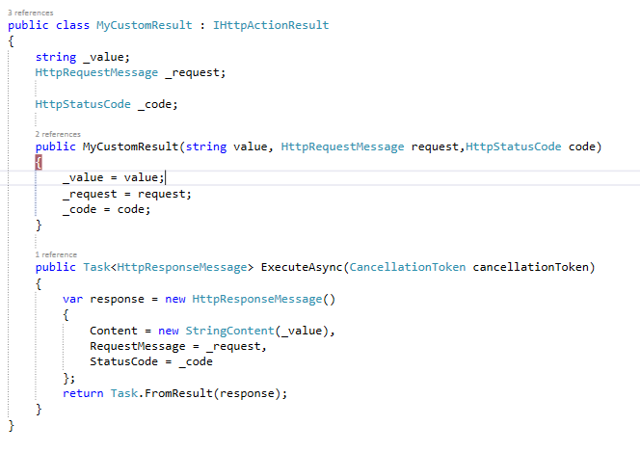
Custom Action Result

Slide 9
Media Type Formatters
Header tells the server that the client wants either HTML, XHTML, or XML. The media type determines how Web API serializes and deserializes the HTTP message body. Web API has built-in support for XML, JSON, BSON, and form-urlencoded data, and you can support additional media types by writing a media formatter.
Media type formatters are classes responsible for serializing request/response data so that Web API can understand the request data format and send data in the format which client expects

Slide 10
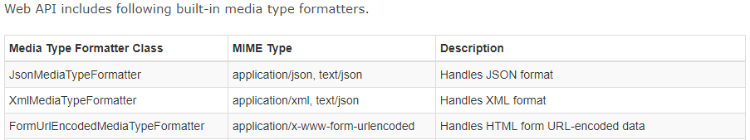

Slide 11
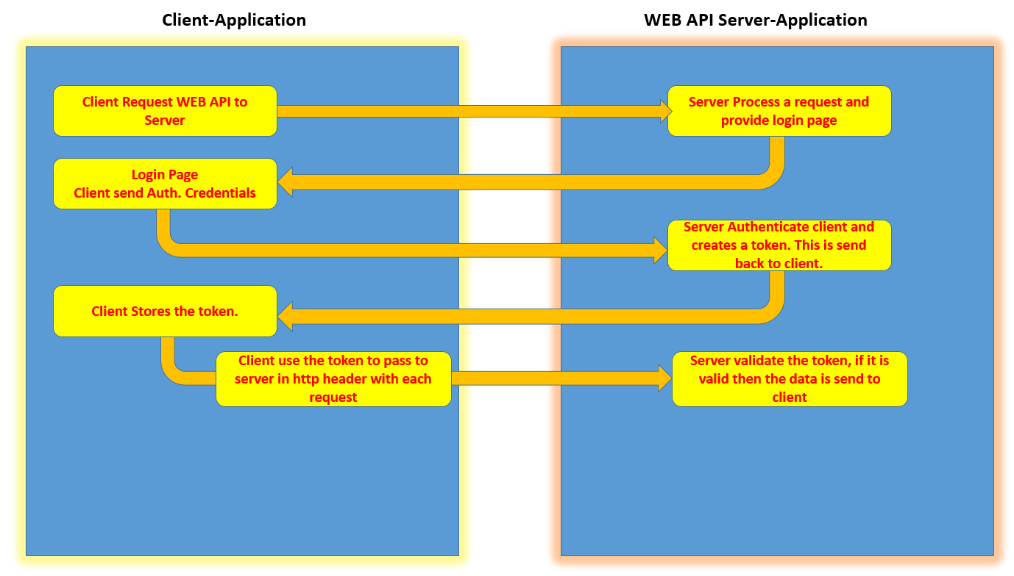
Authentication & Authorization

Slide 12
Advantages of token based Authentication
· The client application is not dependent on a specific authentication mechanism. The token is generated by the server and the Web API have some APIs to understand, validate the token and perform the authentication. This approach provides Loose Coupling between client and the Web API.
· Maintaining cookies in native mobile applications is not an easy task. Using token based authentication, we can now provide support for mobile applications with much ease.

Slide 13
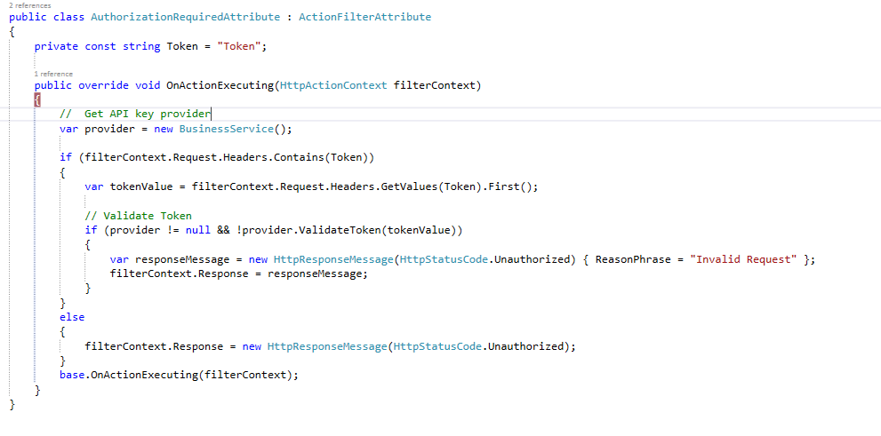

Slide 14
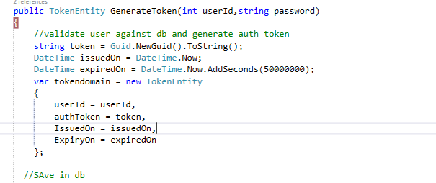

Slide 15
